Slide 1
Math. for CS
Ch 7- Recursive Data Types
Prof. Shunxiang Zhang
Anhui University of Science & Technology
Computer Science and Engineering
Mobile Phone：189-6377-7827
Email：sxzh666@gmail.com;sxzhang@aust.edu.cn

Slide 2
Topics covered/Contents
7.1 Recursive Definitions and Structural Induction
7.2 Strings of Matched Brackets
7.3 Recursive Functions on Nonnegative Integers
7.4 Arithmetic Expressions
7.5 Induction in Computer Science

Slide 3
Ch 7- Recursive Data Types
Recursive data types play a central role in programming, and induction is really all about them.
Recursive data types are specified by recursive definitions, which say how to construct new data elements from previous ones. Along with each recursive data type there are recursive definitions of properties or functions on the data type. Most importantly, based on a recursive definition, there is a structural induction method for proving that all data of the given type have some property.
This chapter examines a few examples of recursive data types and recursively
defined functions on them:
strings of characters,
“balanced” strings of brackets,
the nonnegative integers, and
arithmetic expressions.
two-player games with perfect information.

Slide 4
7.1 Recursive Definitions and Structural Induction
We’ll start off illustrating recursive definitions and proofs using the example of character strings. Normally we’d take strings of characters for granted, but it’s informative to treat them as a recursive data type. In particular, strings are a nice first example because you will see recursive definitions of things that are easy to understand, or that you already know, so you can focus on how the definitions work without having to figure out what they are supposed to mean.
Definitions of recursive data types have two parts:
Base case(s) specifying that some known mathematical elements are in the data type, and
Constructor case(s) that specify how to construct new data elements from previously constructed elements or from base elements.

Slide 5
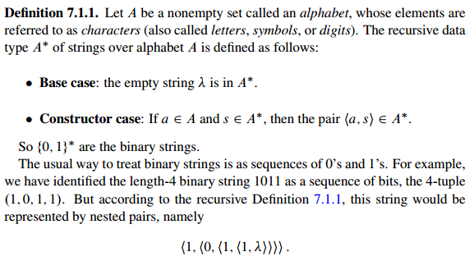
7.1 Recursive Definitions and Structural Induction
The definition of strings over a given character set A follows this pattern:

Slide 6
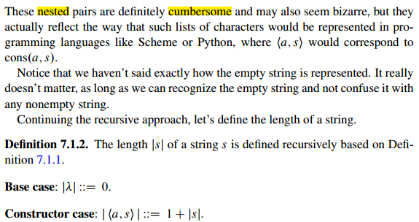
7.1 Recursive Definitions and Structural Induction

Slide 7
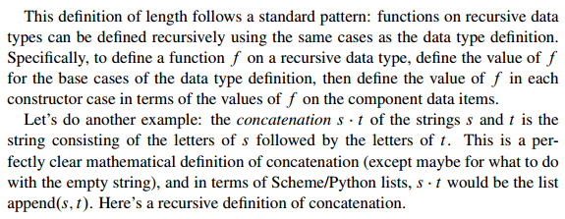
7.1 Recursive Definitions and Structural Induction

Slide 8
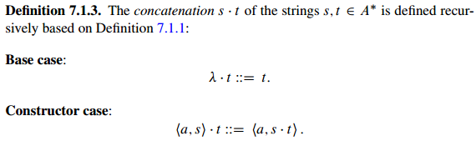
7.1 Recursive Definitions and Structural Induction

Slide 9
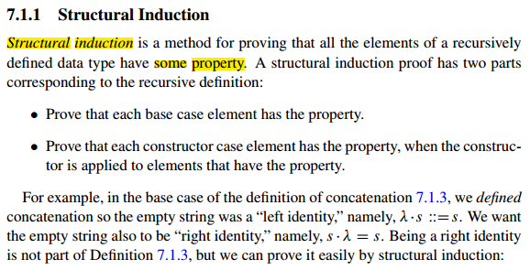
7.1 Recursive Definitions and Structural Induction

Slide 10
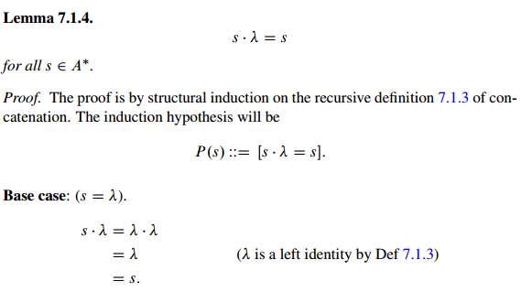
7.1 Recursive Definitions and Structural Induction

Slide 11
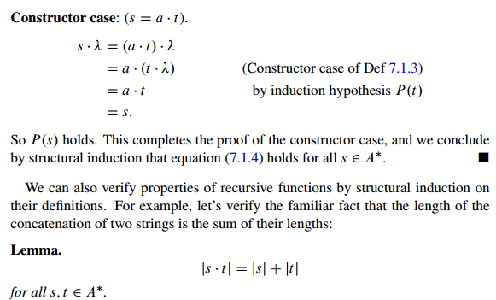
7.1 Recursive Definitions and Structural Induction

Slide 12
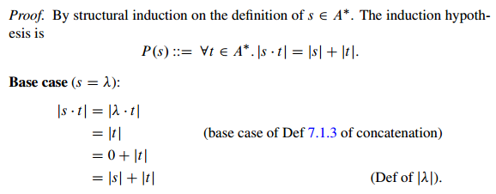
7.1 Recursive Definitions and Structural Induction

Slide 13
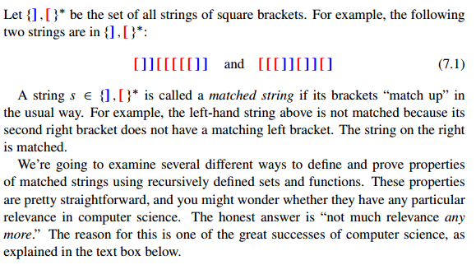
7.2 Strings of Matched Brackets

Slide 14
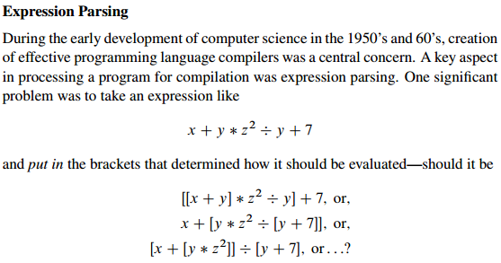
7.2 Strings of Matched Brackets

Slide 15
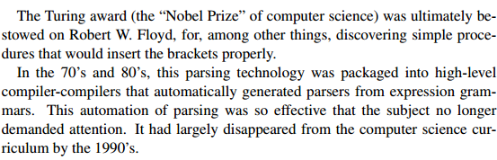
7.2 Strings of Matched Brackets

Slide 16
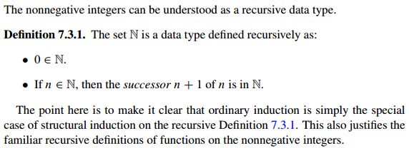
7.3 Recursive Functions on Nonnegative Integers

Slide 17
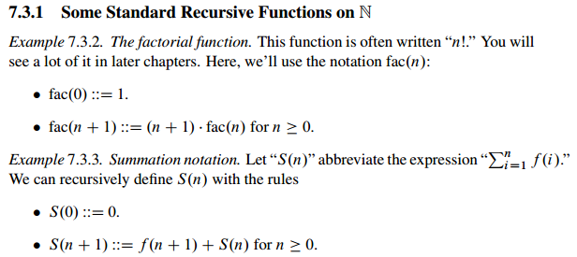
7.3 Recursive Functions on Nonnegative Integers

Slide 18
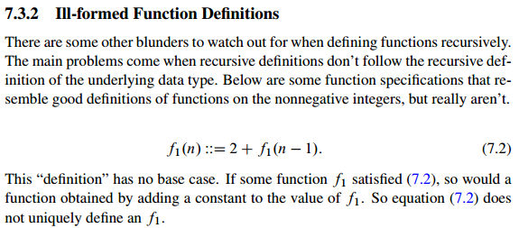
7.3 Recursive Functions on Nonnegative Integers

Slide 19
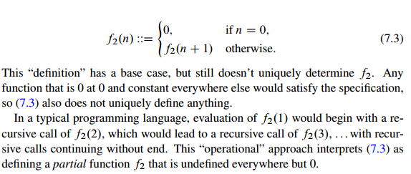
7.3 Recursive Functions on Nonnegative Integers

Slide 20
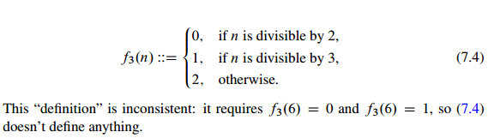
7.3 Recursive Functions on Nonnegative Integers

Slide 21
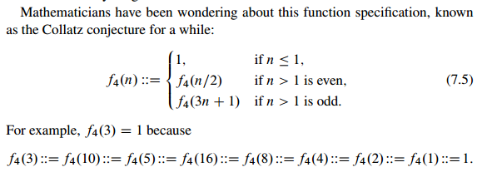

7.3 Recursive Functions on Nonnegative Integers

Slide 22
7.4 Arithmetic Expressions

Slide 23
7.5 Induction in Computer Science

Slide 24

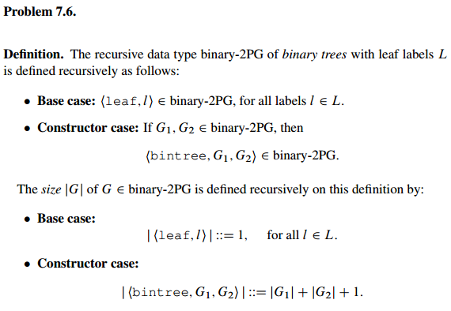
7.6 Group/Panel discussion
Group 1

Slide 25
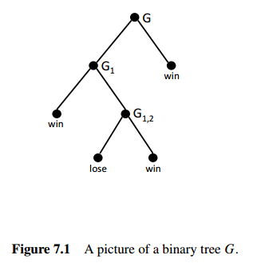
7.6 Group/Panel discussion
Group 1

Slide 26
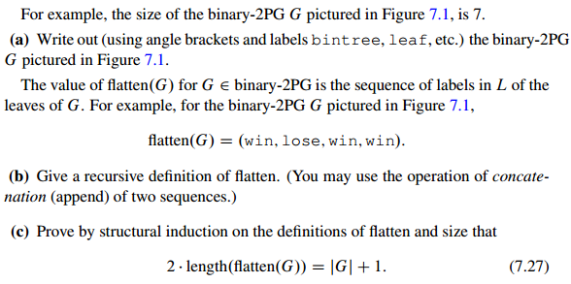
7.6 Group/Panel discussion
Group 1

